Slide 1

Principles of Economics
Swagat Kishore Mishra
Lecturer, Dept. of Economics
Email: swagat@bits-goa.ac.in / sayswagat@gmail.com
VOIP: 207 PSRN: 485 CHAMBER: A-301/16
Tel. 0832-2580207 (O) 08879506995 (M)
1st Lecture

Slide 2
Contents
Definition, Scope and Method of Economics
Economic Problem of Scarcity and Choice
Elements of Market Economy
Consumer Behaviour
Producer Behaviour

Slide 3
Economics
Defination: The study of the use of limited resources for the achievement of alternative ends.
Scope: Explanation and Prediction are twin goals.
Method: Economic theory engulfs 3 criterions i.e.
Data outside the analytical framework containing parameters,
Variables whose magnitude are determined within the theory,
and Postulates or behaviour assumptions allowing operations to estimate the value of variables.

Slide 4
Positive and Normative Economics
Micro and Macro Economics
Comparative Static Analysis and Comparative Dynamics
Positive and Normative Economics are entwined.
Former focuses on value-free descriptions/predictions of economic relationships.
Latter focuses on value by willing to establish what ought to be rather what it is.
i.e. Equity of wealth and resources is a value judgement.
Economic policy is the centroid of the triangle which has Positive theories, Empirical facts and Normative goals as the vertices.
Hence, positive analysis studies cause and effect relationship while normative analysis is value judgement oriented.
If you took all of the economists in the country and laid them end to end, they'd never reach a conclusion….. George Bernard Shaw

Slide 5
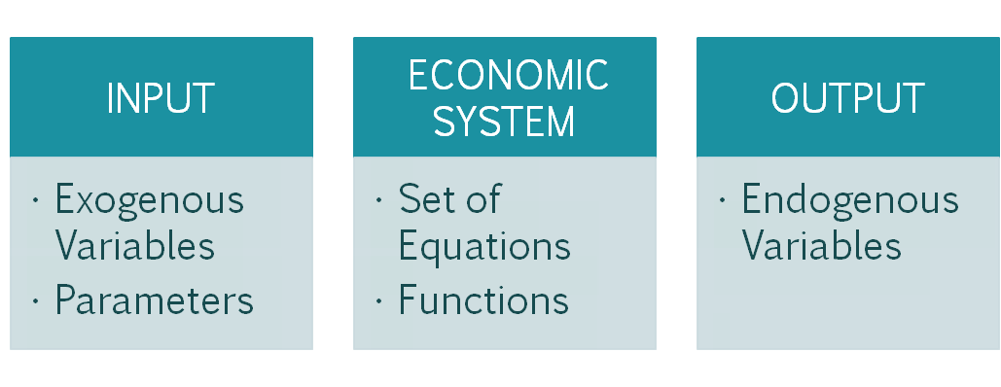
Microeconomics: Diligent inquiry and discipline of the economic actions of individuals and well-defined group of individuals.
Macroeconomics: Diligent inquiry and discipline of broad aggregates on functions of an Economy.
Comparative Static Analysis: Equivalence of old and new equilibrium levels.
Comparative Dynamics: Traces out path over time.

Slide 6
Principles of Economics
POE deals with both the sides of the same coin.
i.e.
HEADS: Social Science of Human action on the Economy
TAILS: Science of wealth
‘Thus POE outlines the process of creation of wealth in relation to the diversity of individual’s wants.’

Slide 7
Economic Problem of Scarcity and Choice
Economic choice of decision making involves choosing/prioritising between alternate uses of scarce resources.
MARKET | CUSTOMERS | PRODUCERS
Product Market | Individuals | Firms
Factor Market | Firms | Individuals

Slide 8
Elements of Market Behaviour
Demand
Supply
Equilibrium
CUSTOMERS => DEMAND
PRODUCERS => SUPPLY
DEMAND = SUPLLY => EQUILIBRIUM
i.e. No Shortage, No Surplus and Equilibrium Price clears the Market

Slide 9
ECONOMISTS for POE
Okun, Arthur
Stigler, George J.
Coase, Ronald H.
Galbraith, John K.
Kuznets, Simon
Lucas, Robert E.
Becker, Gary
Feldstein, Martin
Keynes, John Maynard
Smith, Adam
Friedman, Milton
Ricardo, David
Marx, Karl
Malthus, Thomas
Marshall, Alfred
Schumpeter, Joseph

Slide 10
Thanking
BITS PILANI, K.K.BIRLA GOA CAMPUS
Under the aegis of
Department of Economics
Dr. Debashish Pattanaik
Dr. Mridula Goel (HOD)
Dr. Aswini Kumar Mishra
Dr. Kubendran N.
Dr. Indranil De
Ms. Ambili K.
Mr. Swagat Kishore Mishra

